Slide 1

Housing Price Prediction
Submitted by:
AKASH TALWAR

Slide 2
Problem Statement
Houses are one of the necessary need of each and every person around the globe and therefore housing and real estate market is one of the markets which is one of the major contributors in the world’s economy. It is a very large market and there are various companies working in the domain. Data science comes as a very important tool to solve problems in the domain to help the companies increase their overall revenue, profits, improving their marketing strategies and focusing on changing trends in house sales and purchases. Predictive modelling, Market mix modelling, recommendation systems are some of the machine learning techniques used for achieving the business goals for housing companies. Our problem is related to one such housing company.
A US-based housing company named Surprise Housing has decided to enter the Australian market. The company uses data analytics to purchase houses at a price below their actual values and flip them at a higher price. For the same purpose, the company has collected a data set from the sale of houses in Australia. The data is provided in the CSV file below.
The company is looking at prospective properties to buy houses to enter the market. You are required to build a model using Machine Learning in order to predict the actual value of the prospective properties and decide whether to invest in them or not. For this company wants to know:
• Which variables are important to predict the price of variable?
• How do these variables describe the price of the house?

Slide 3
Business Goal
You are required to model the price of houses with the available independent variables. This model will then be used by the management to understand how exactly the prices vary with the variables. They can accordingly manipulate the strategy of the firm and concentrate on areas that will yield high returns. Further, the model will be a good way for the management to understand the pricing dynamics of a new market.
Technical Requirements:
• Data contains 1460 entries each having 81 variables.
• Data contains Null values. You need to treat them using the domain knowledge and your own understanding.
• Extensive EDA has to be performed to gain relationships of important variable and price.
• Data contains numerical as well as categorical variable. You need to handle them accordingly.
• You have to build Machine Learning models, apply regularization and determine the optimal values of Hyper Parameters.
• You need to find important features which affect the price positively or negatively.

Slide 4
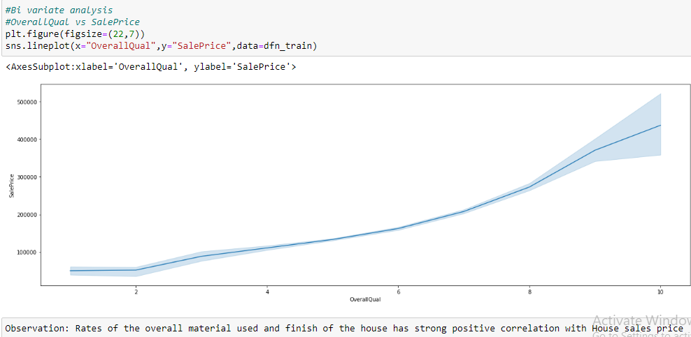
EDA: Exploratory Data Analysis
Features that positively contribute to Sale Price (target variable)
1. OverallQual: Rates the overall material and finish of the house

Slide 5
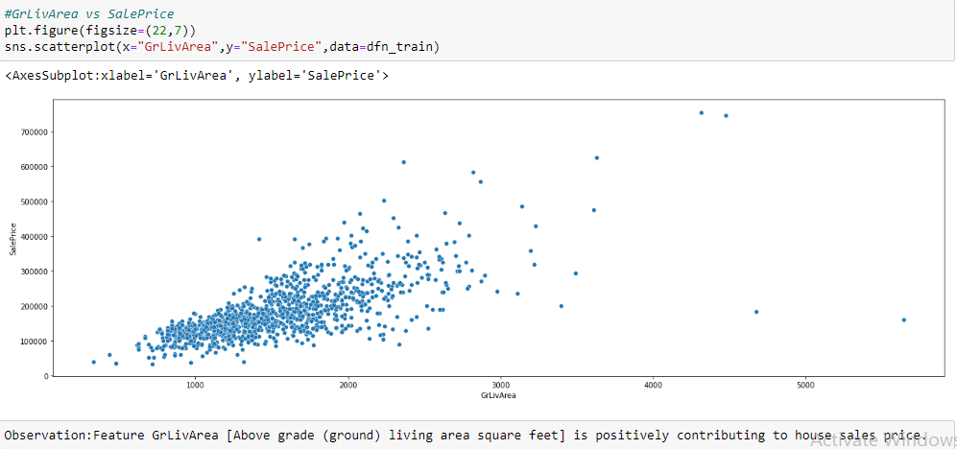
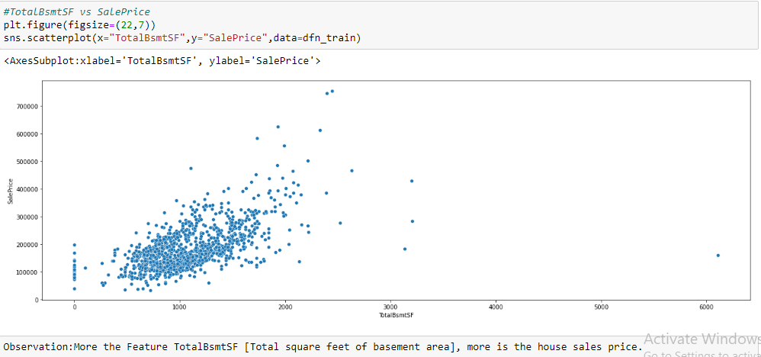
Features that positively contribute to Sale Price (target variable)
2. GrLivArea: Above grade (ground) living area square feet
3. TotalBsmtSF: Total square feet of basement area

Slide 6
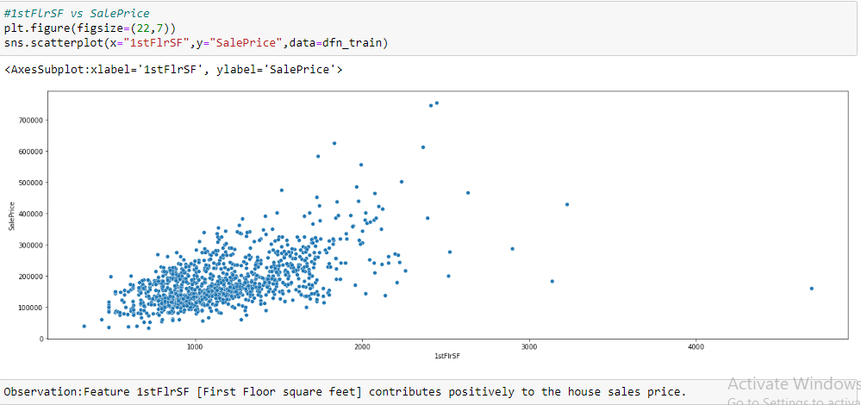
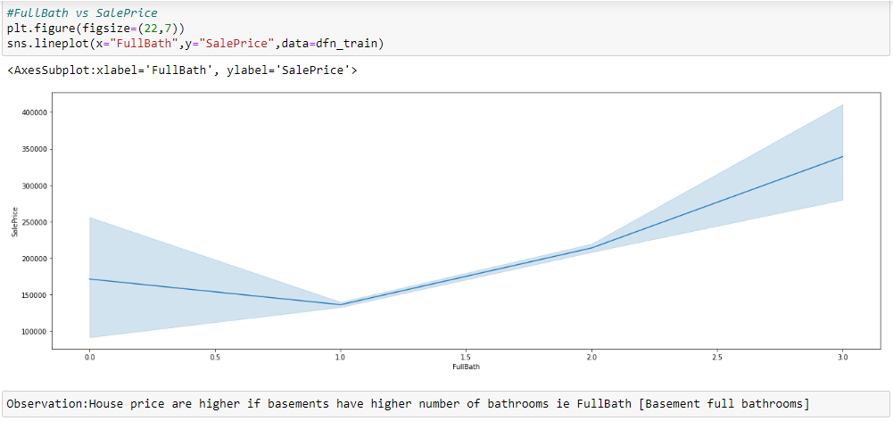
Features that positively contribute to Sale Price (target variable)
4. 1stFlrSF: First Floor square feet
5. BsmtFullBath: Basement full bathrooms

Slide 7
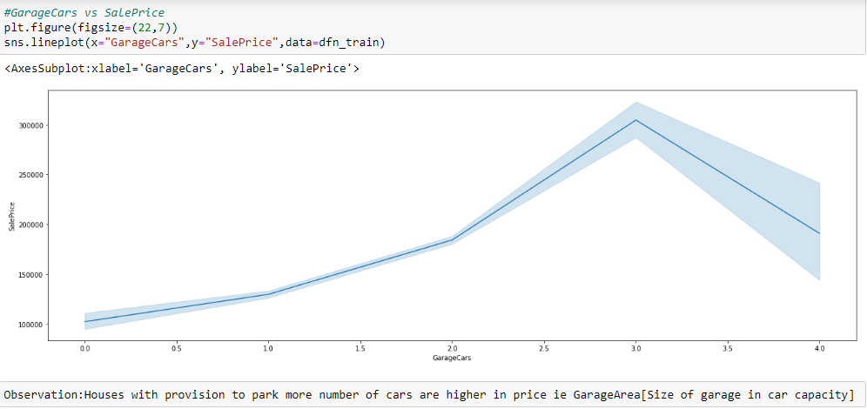
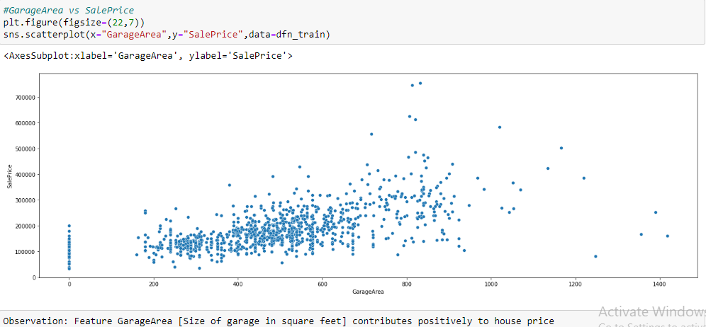
Features that positively contribute to Sale Price (target variable)
6. GarageCars: Size of garage in car capacity
7. GarageArea: Size of garage in square feet

Slide 8
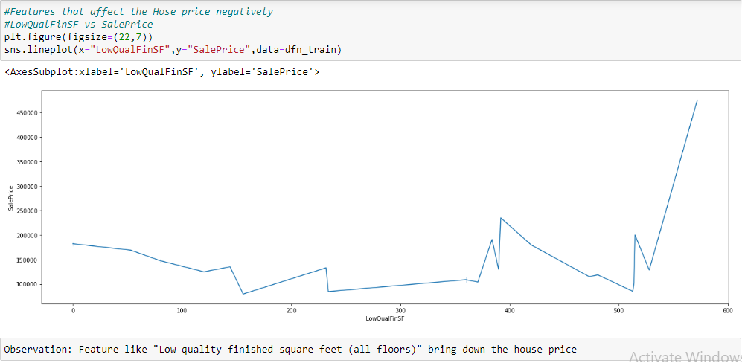
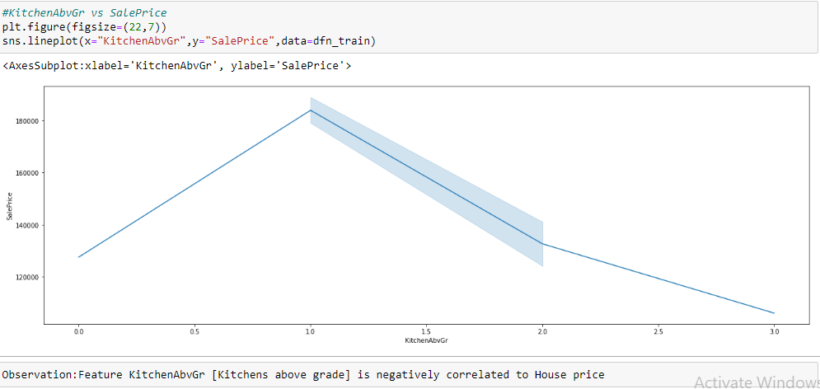
Features that negatively affect Sale Price (target variable)
1. LowQualFinSF: Low quality finished square feet (all floors)
2. Kitchen: Kitchens above grade

Slide 9
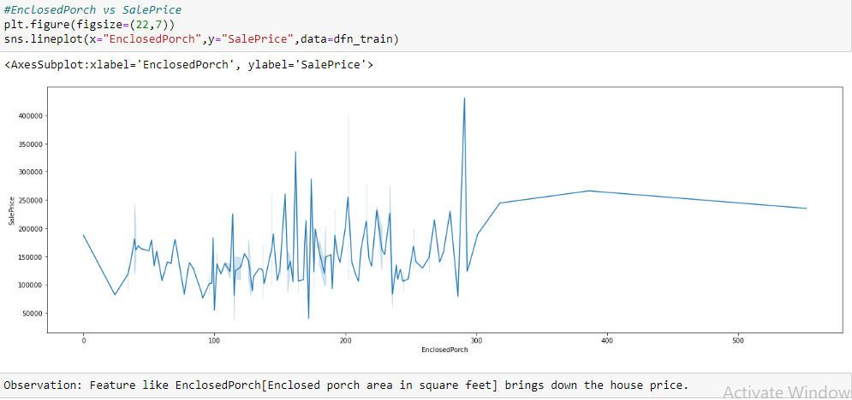
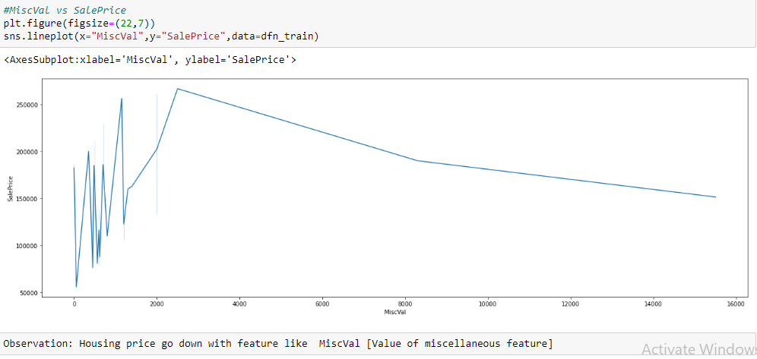
Features that negatively affect Sale Price (target variable)
3. EnclosedPorch: Enclosed porch area in square feet
4. MiscVal: Value of miscellaneous feature

Slide 10
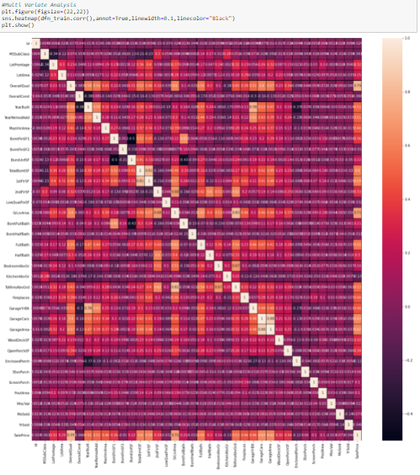
Numerical features that are Correlated with eachother

Slide 11
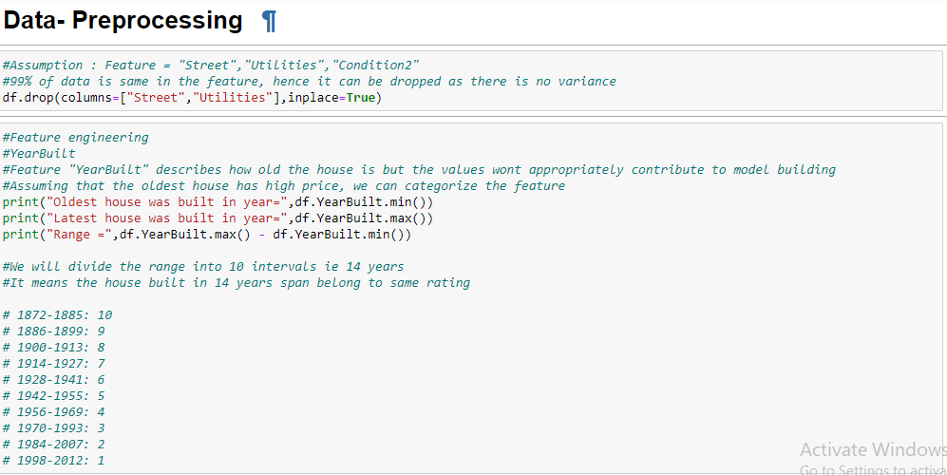
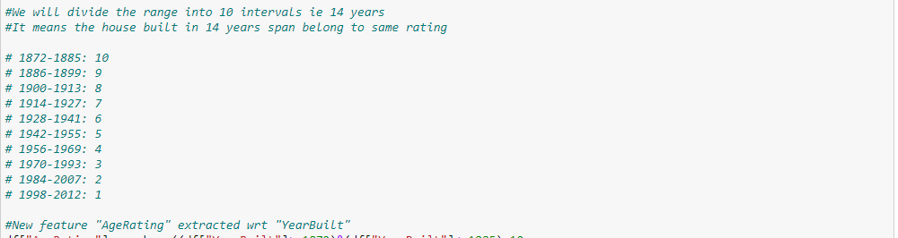
Assumption:

Slide 12
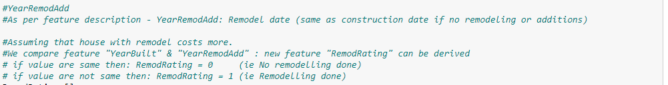
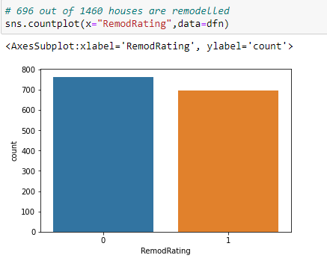
Assumption:

Slide 13
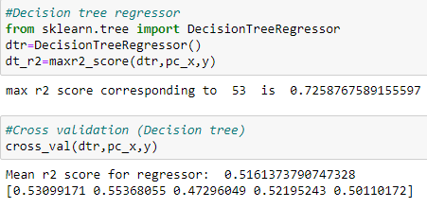
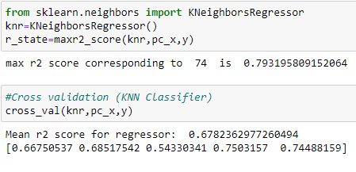
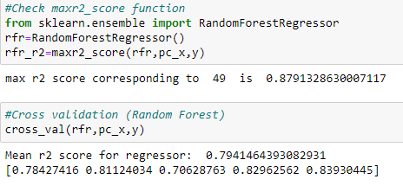
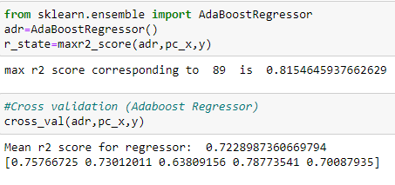
Model Building & Cross Validation
1. Decision Tree Regressor
2. K Nearest Regressor
3. Random Forest Regressor
4. Ada-Boost Regressor

Slide 14
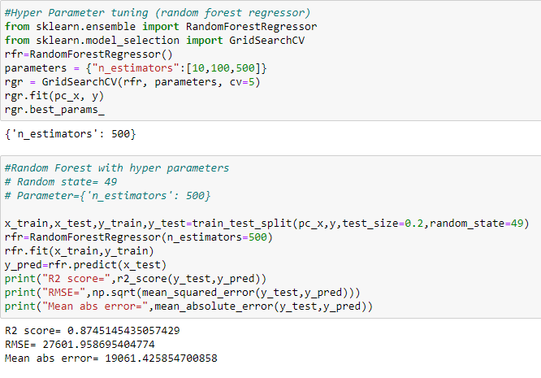
Finalized Model
Random Forest is the best performing model.
Hyper Parameter Tuning & Model testing with Hyper Parameters

Slide 15






Conclusion
Using Random Forest model the House Sales Price is predicted for test data.
Predicted values for 292 test datapoints.

Slide 16
Thank You

